Slide 1
Water Level Tracking Dashboard
309 | Bipashree Aryal
Project Defense of Project-I – CAPJ 256 – Class of 2024

Slide 2
Outline
Introduction
Problem Statement
Objective
Scope
Literature Review/Background Study
Methodology
Tools and Technology
Conclusion
Reference

Slide 3
Introduction
Water Level Tracking Dashboard
Combines Hardware and Software components to monitor the water level in Household/Commercial Water Tanks.

Slide 4
Problem Statement
Most Households/Commercial settings rely on groundwater as their primary source of water.
During the winter season the groundwater levels plummet making it essential for proper management of available water.

Slide 5
Objective
To accurately display water consumption in a Residential/Commercial setting.
To monitor water consumption at specific times of the day and facilitate the user to take action to reduce consumption.
To turn the water pump automatically if the water levels falls below a specific level and to turn it off automatically when the water level rises to a specified level.

Slide 6
Scope
What the system does:
Display a detailed information with graphs regarding the water consumption with respect to time.
Turns the water pump on and off when required.
What the system does not do:
Inherently decrease the water consumption, it only provides insights on the water consumption.
Does not provide insights on water consumption from individual outlets

Slide 7
Literature Review/Background Study
Upon Research, it was found that no current products in the market provide as much value as the Water Level Tracking Dashboard.

Slide 8
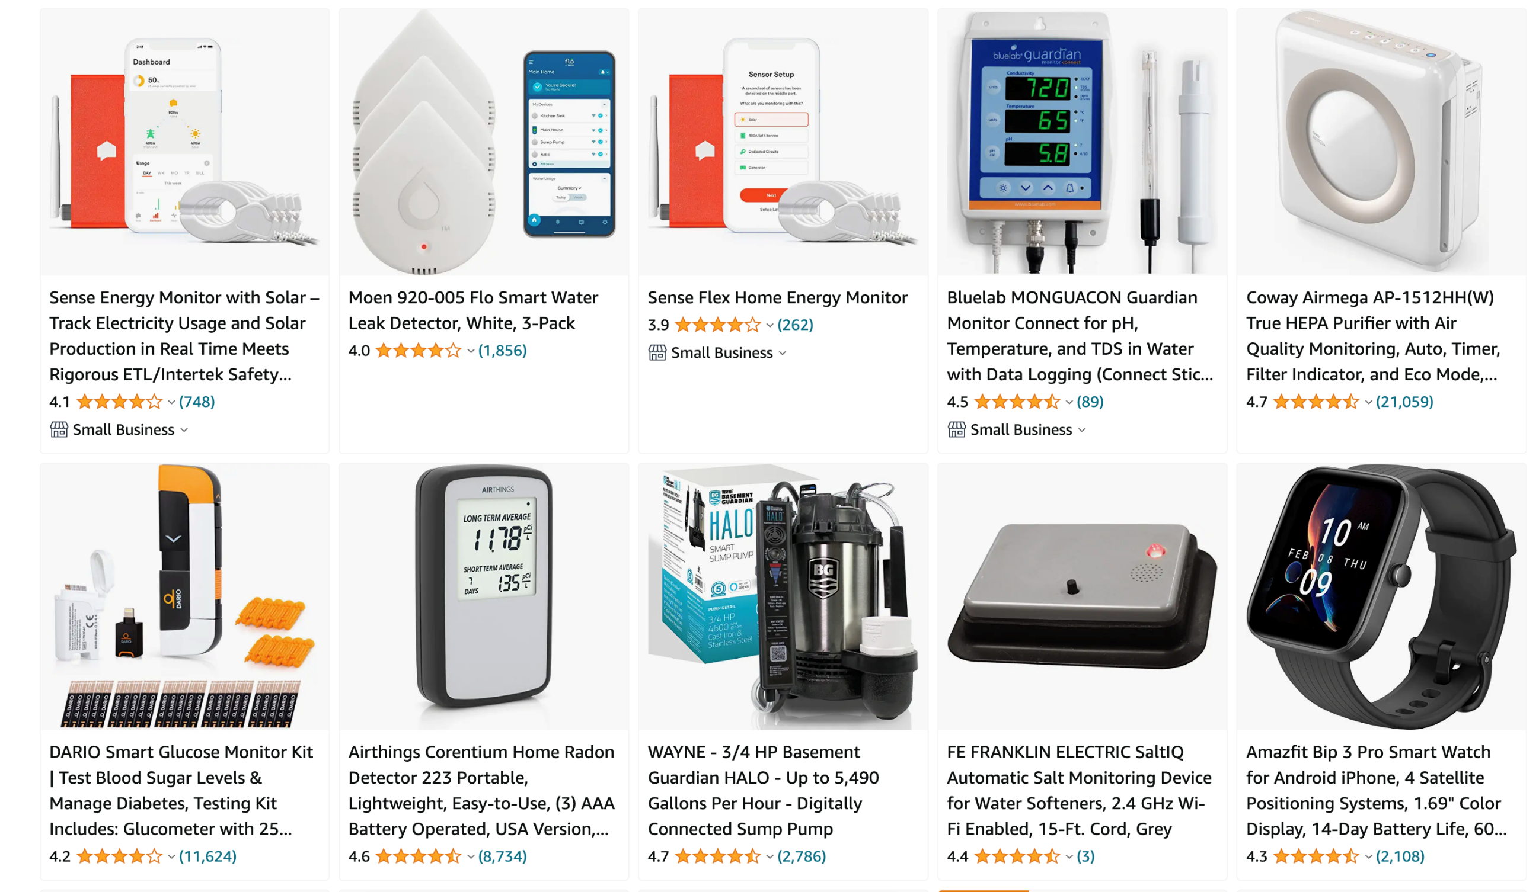

Slide 9
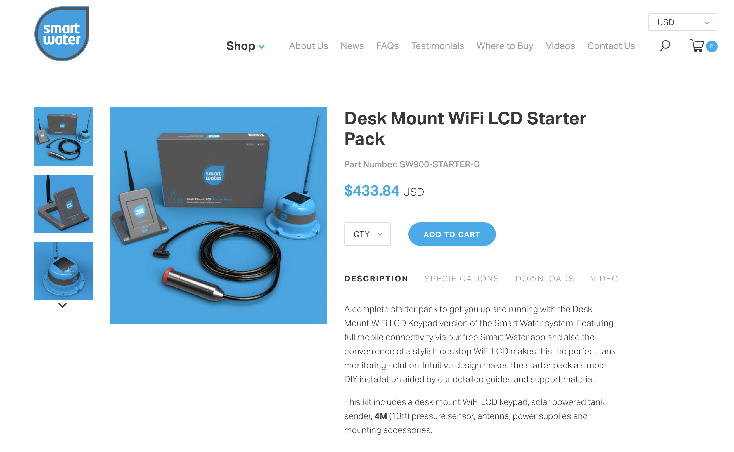

Slide 10
Methodology

Slide 11
Requirement Identification
Study of Existing Systems
There are currently no budget options that compete with the “Water Level Monitoring Dashboard”
Ivent Solutions Limited has a competing solution (Smart Water Online), but it costs a total of $433.84 [4]

Slide 12
Requirement Identification
Requirement Collection
Functional Requirements:
The device shall always track the water level and feed data to the database when powered on.
The Dashboard shall be easily accessible by the user to gain analytics data.
The device shall automatically turn on and/or off the Water Pump based on the level of water present in the tank.

Slide 13
Requirement Identification
Requirement Collection
Non-Functional Requirements:
The system shall be easy to install and operate.
The UI shall be intuitive to track data.

Slide 14
Feasibility Study
Technical Feasibility
The Raspberry Pi recurringly runs a Golang program to calculate the water level.
The program uses a GPIO Interfacing Package to import data from the HC-SR04 Module
All software components used are open-source.
All hardware components used are available readily in Nepali Market.

Slide 15
Feasibility Study
Operational Feasibility
The Hardware component is install-once-use-forever solution.
It resides on the lid of the water tank.

Slide 16
Feasibility Study
Economic Feasibility
All the software components are open-source.
The hardware components are available for a collective total of around Rs. 1,500 NPR.

Slide 17
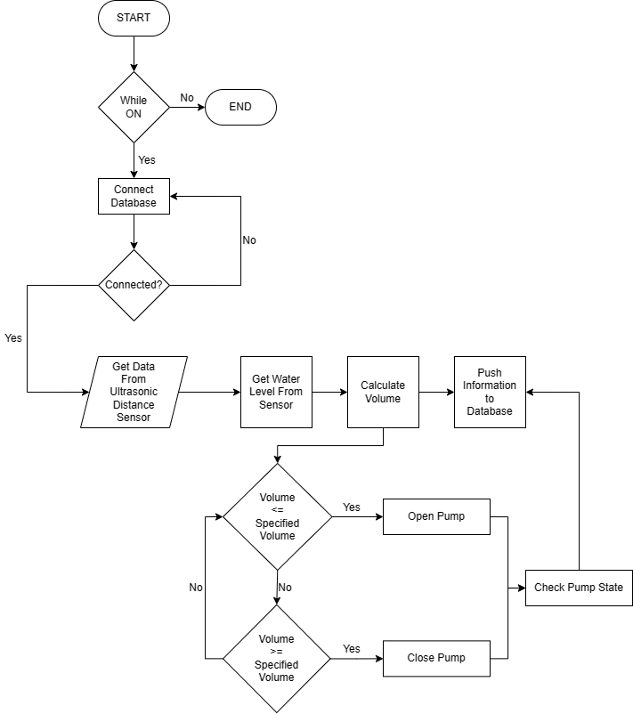
System Design
Flowchart

Slide 18
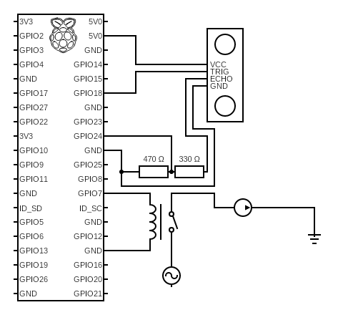
System Design
Circuit Diagram

Slide 19
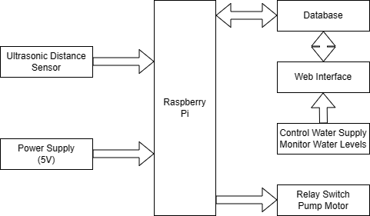
System Design
Block Diagram

Slide 20
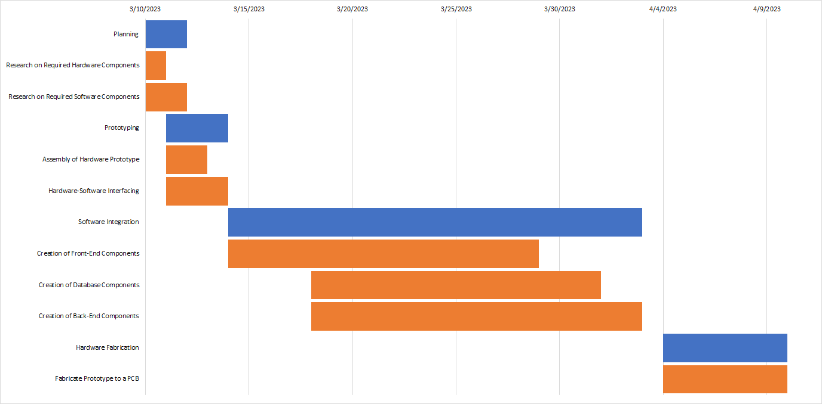
Gantt Chart

Slide 21
Expected Outcome
Upon Completion:
Hardware Component must be able to run the Golang program indefinitely.
The water level data must be stored in a database continuously

Slide 22
Conclusion
This project aims to work towards enhancing the convenience in a normal household.
It eliminates the hassle and stress that comes with manual operation of a water pump.

Slide 23
References
[1] A. N. R. L. Steven Sachio, "CORE," 14 12 2018. [Online]. Available: https://www.core.ac.uk. [Accessed 10 03 2023].
[2] M. M. A. K. V. M. Shweta Karad, "IoT Based Water Level Control System," CORE, vol. 3, no. 4, p. 251, 4 4 2018.
[3] P. J and S. Chekuri, "Water Level Monitoring System Using IoT," International Research Journal of Engineering and Technology (IRJET), vol. 4, no. 12, p. 1817, 2017.
[4] "Smart Water Online," Ivent Solutions Limited, 16 2 2021. [Online]. Available: https://smartwateronline.com/. [Accessed 14 3 2023].
[5] “Golang GPIO Package,” pkg.go.dev. https://pkg.go.dev/periph.io/x/periph/conn/gpio [Accessed 19 3 2023].

Slide 24
Thank You!!!!!

